Slide 1
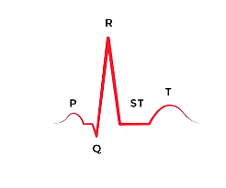
Time-Frequency Analysis of Non-Stationary
Electrocardiogram Signals Using
Hilbert- Huang Transform
Rajashekar Ch (2018122010)
Sai Krishna Charan D (20171140)
Link to Video : https://youtu.be/9XWQyhUR9ZQ

Slide 2
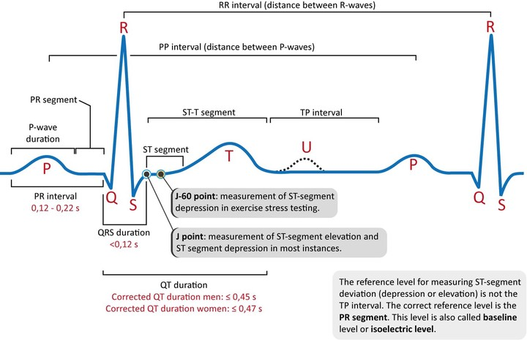
Electrocardiogram (ECG)
Electrocardiogram signal - non stationary ( interfered with muscle potentials or noise or other frequencies)
Potential Difference between two electrodes v/s time
P wave
Contraction of Atria
QRS complex
Contraction of Ventricles
T wave
Repolarization of Ventricles
U wave
Exact significance not known
An extension of repolarization

Slide 3
Why Time Frequency Analysis for ECG?
The heart signals are non-stationary and might have abrupt changes in the time domain.
To know more accurately about the condition of the patient the shift toward frequency domain has been proposed.
Non-stationarity effects the variations in the frequency domain.
Proposed methods - therefore require time-frequency analysis.

Slide 4
Considered Methods
STFT
Wavelet Transform
Wigner Ville
HHT - main focus

Slide 5
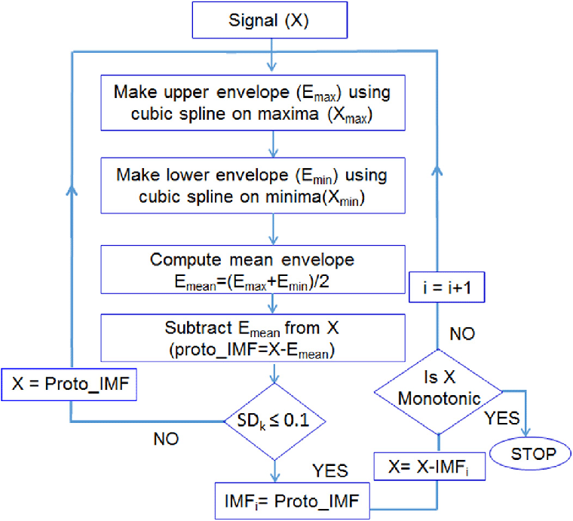
Constructing EMF’s (HHT)

Slide 6
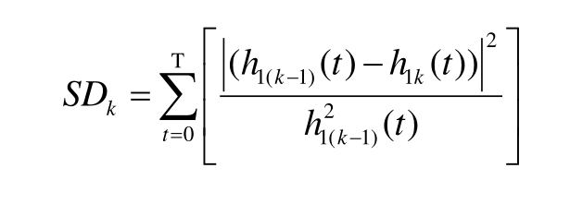
Constructing EMF’s (HHT)

Slide 7
Empirical Mode Decomposition (EMD)
while ~ismonotonic(x)
x1 = x;
sd = Inf;
while (sd > 0.1) | ~isimf(x1)
s1 = getspline(x1);
s2 = -getspline(-x1);
x2 = x1-(s1+s2)/2;
sd = sum((x1-x2).^2)/sum(x1.^2);
x1 = x2;
end
imf{end+1} = x1;
x = x-x1;
end
imf{end+1} = x;

Slide 8
Empirical Mode Decomposition (EMD)
while ~ismonotonic(x)
x1 = x;
sd = Inf;
while (sd > 0.1) | ~isimf(x1)
s1 = getspline(x1);
s2 = -getspline(-x1);
x2 = x1-(s1+s2)/2;
sd = sum((x1-x2).^2)/sum(x1.^2);
x1 = x2;
end
imf{end+1} = x1;
x = x-x1;
end
imf{end+1} = x;
Stoppage Criteria:
Squared difference sd is smaller than predetermined threshold, sifting process will be stopped.

Slide 9
Empirical Mode Decomposition (EMD)
while ~ismonotonic(x)
x1 = x;
sd = Inf;
while (sd > 0.1) | ~isimf(x1)
s1 = getspline(x1);
s2 = -getspline(-x1);
x2 = x1-(s1+s2)/2;
sd = sum((x1-x2).^2)/sum(x1.^2);
x1 = x2;
end
imf{end+1} = x1;
x = x-x1;
end
imf{end+1} = x;
Stoppage Criteria:
Squared difference sd is smaller than predetermined threshold, sifting process will be stopped.
Append to imf list:
Add to imf list if the condition for imf is satisfied.

Slide 10
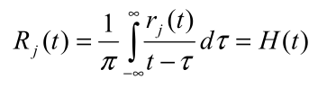
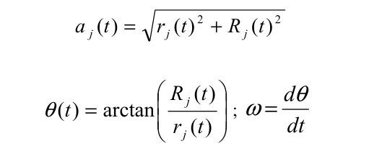
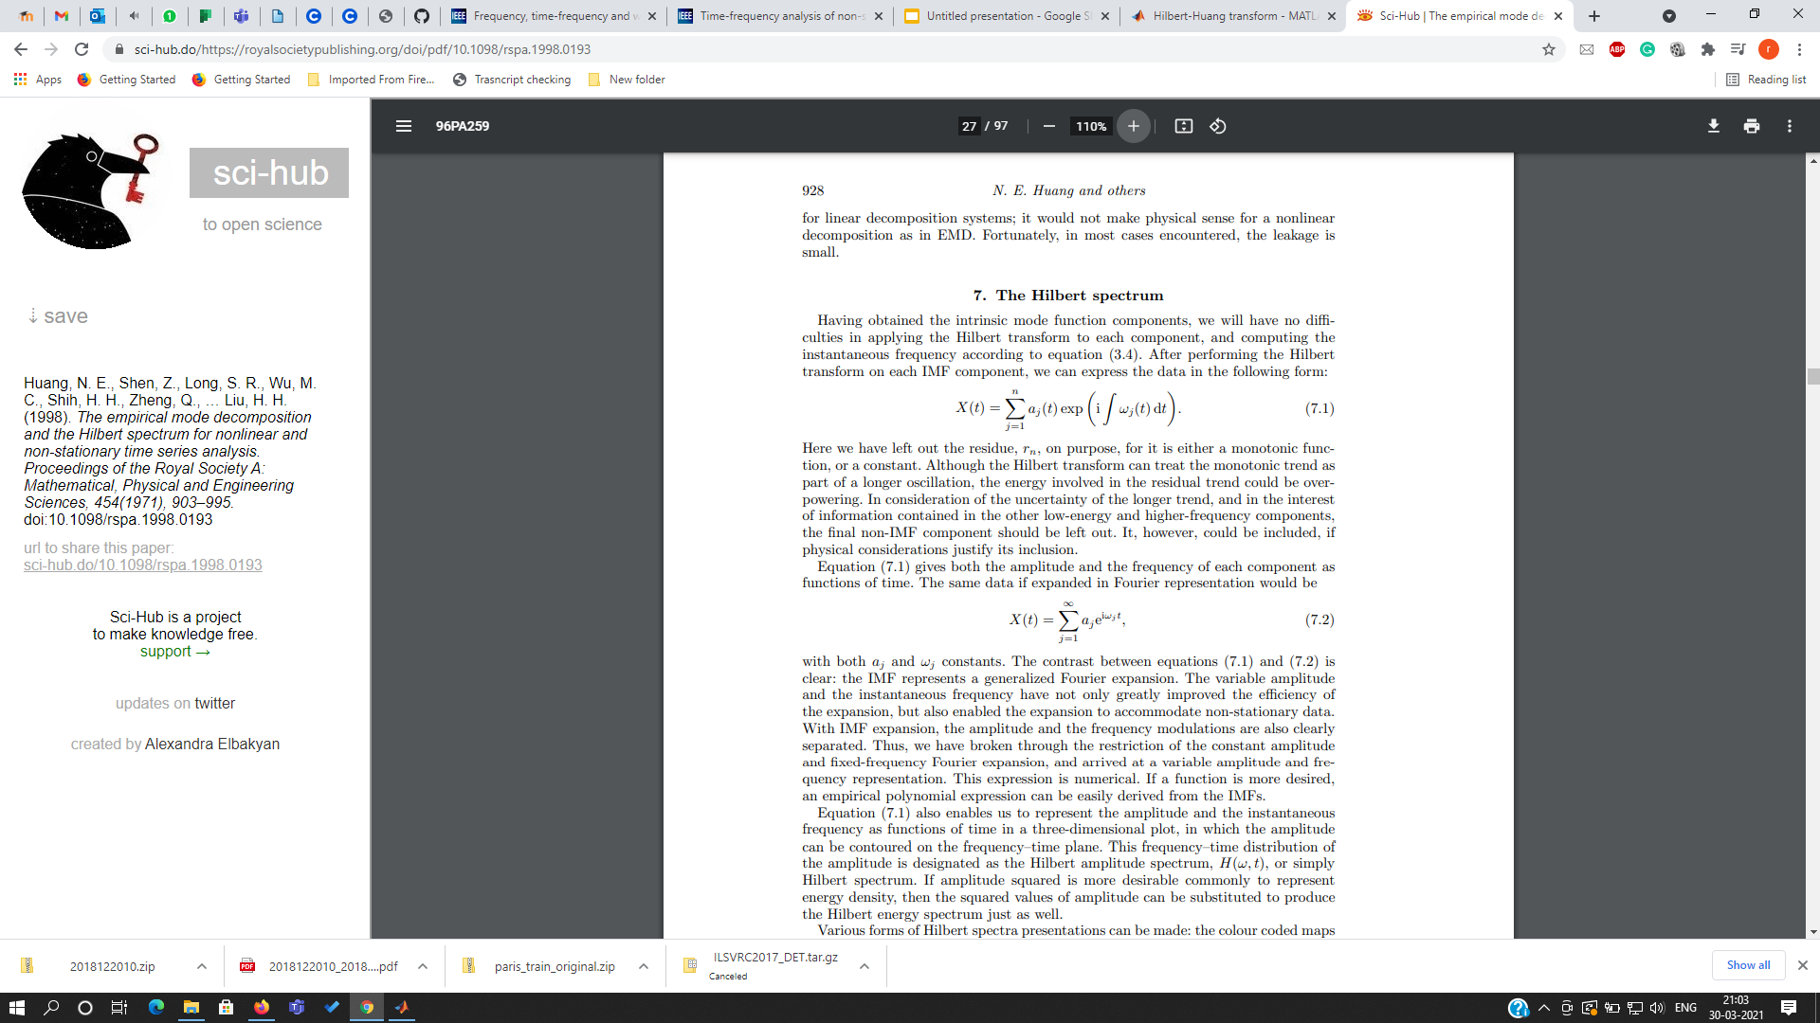
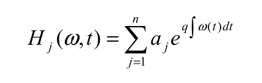
Hilbert Transform
For xi ϵ {x1,x2,...xn} xi is an IMF
zi(t)=xi(t)+jH{xi(t)} where H{} is hilbert transform
ai(t)=amplitude(zi(t))
𝛉i(t)=phase(zi(t))
inst_energy(i,t)=|ai(t)|²
inst_frequency(i,t)=diff(𝛉i(t))
end

Slide 11
Results

Slide 12
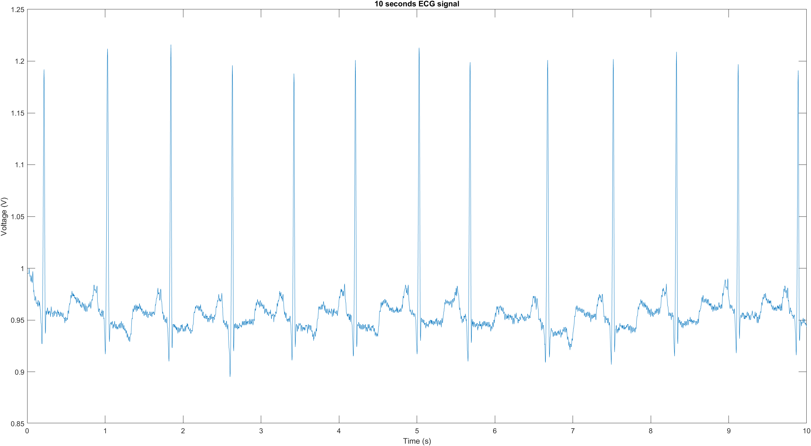
Dataset
The database to be used is MIT-BIH Arrhythmia Database- https://www.physionet.org/content/mitdb/1.0.0/
48 half-hour excerpts of two-channel ambulatory ECG recordings, obtained from 47 subjects
Digitized at 360 samples per second per channel with 11-bit resolution over a 10 mV range.
Available in “*.dat” format

Slide 13
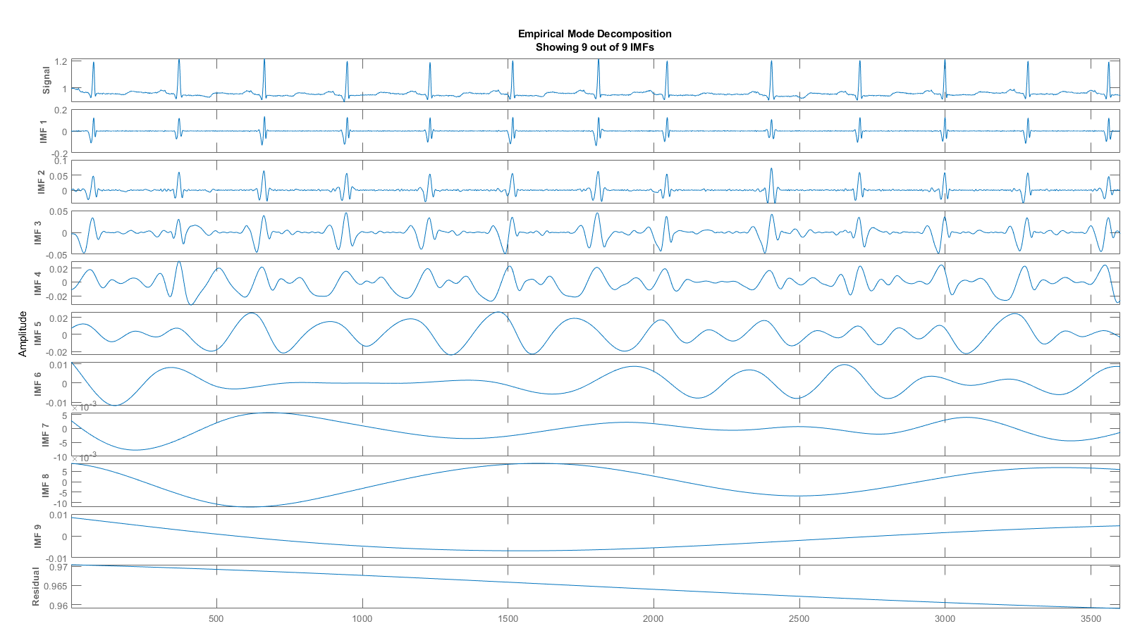
EMD Step - IMFs

Slide 14
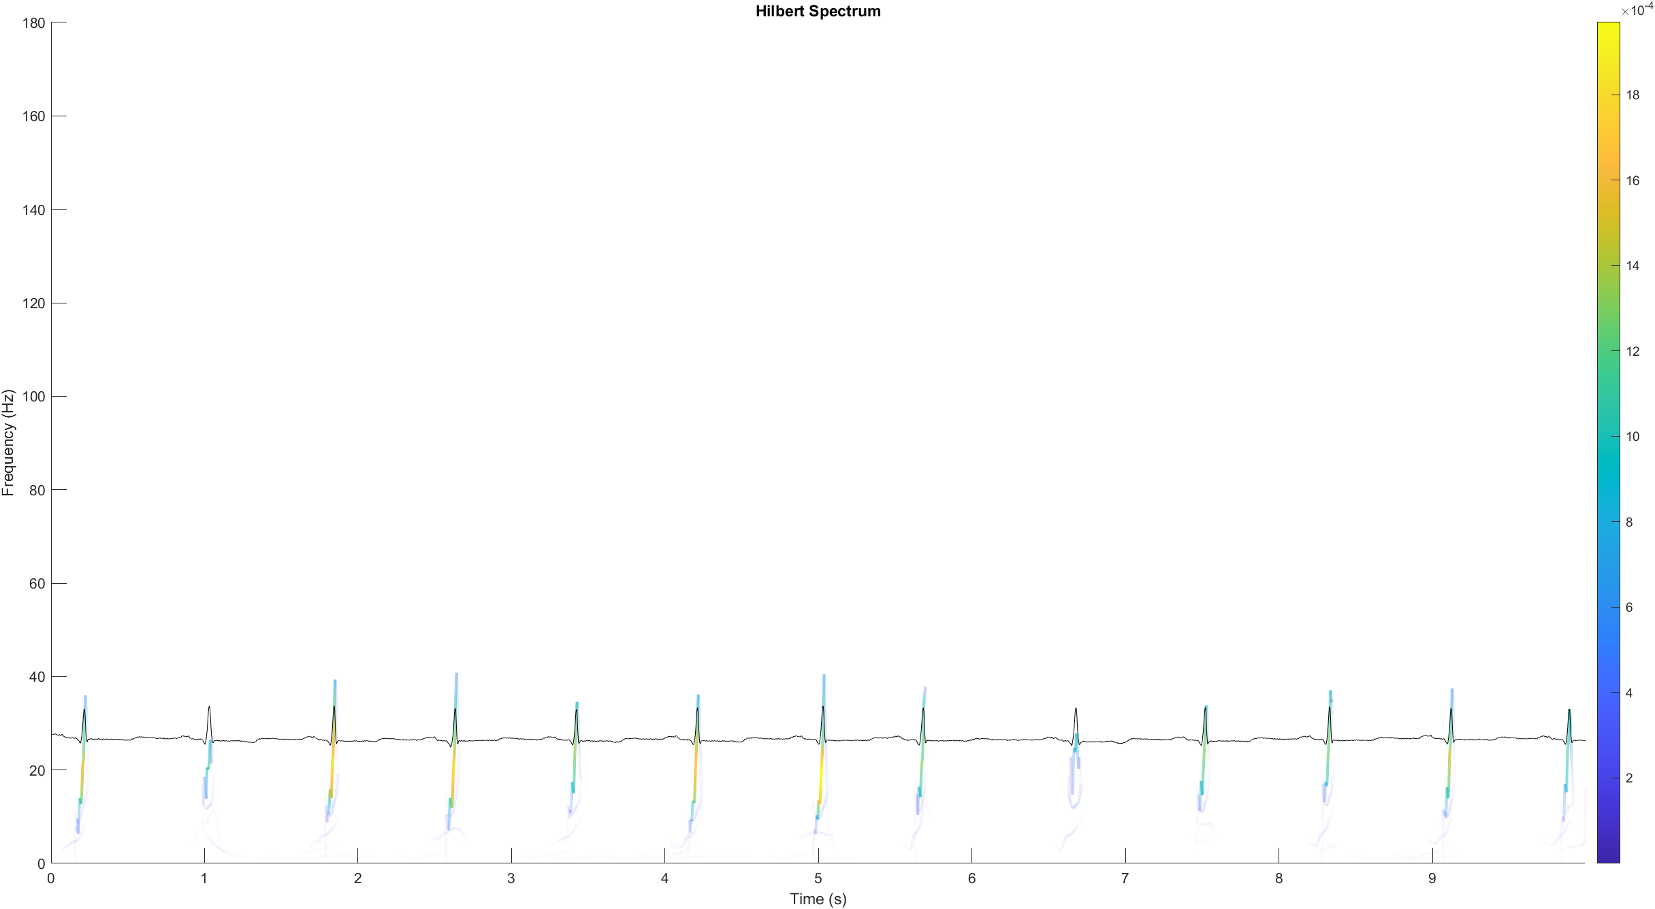
HHT Spectrum

Slide 15
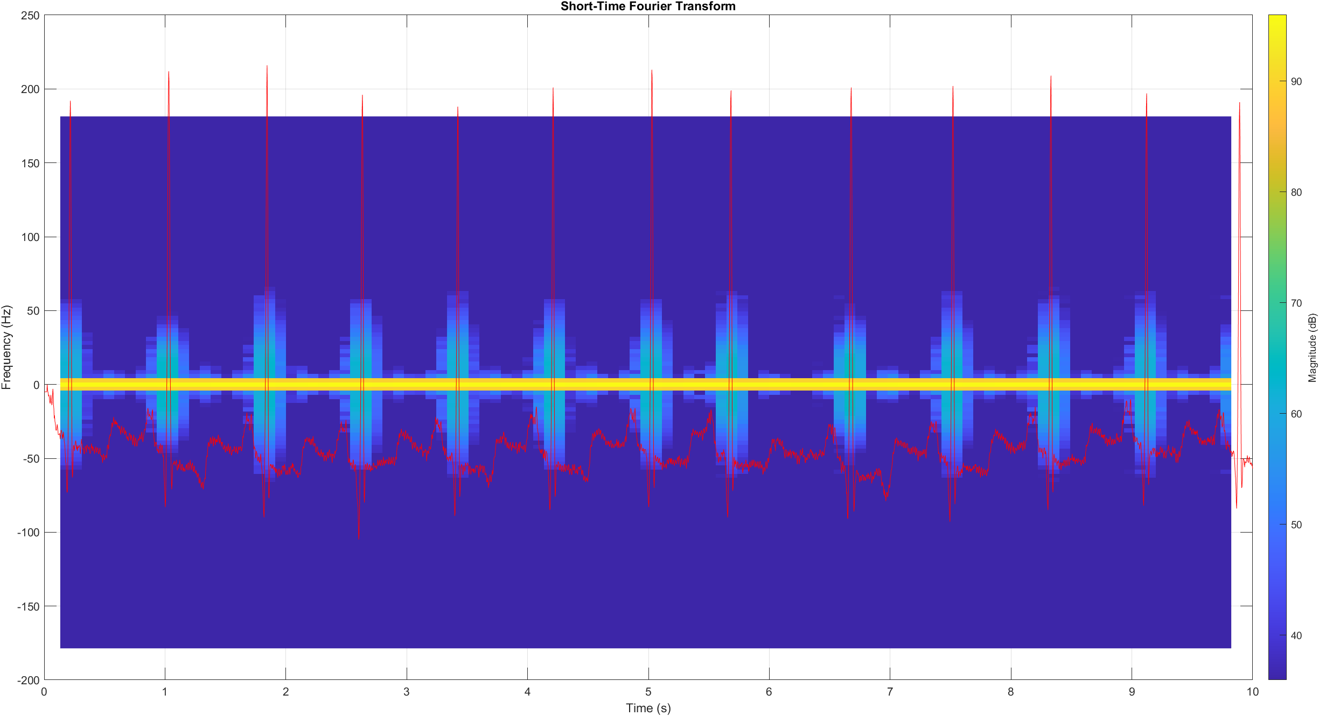
STFT
WIndow= Hann(128,periodic)
Overlap = 75%
FFT length=128
Notes:
The STFT spectrum has been shown here. The window used is a periodic hanning window with length of 128. We have used the Overlap of 75% and the FFT length is set to be default of 128. We can see here that the STFT spectrum was able to identify the peaks but it was too spread across the time due to the overlapping nature.

Slide 16
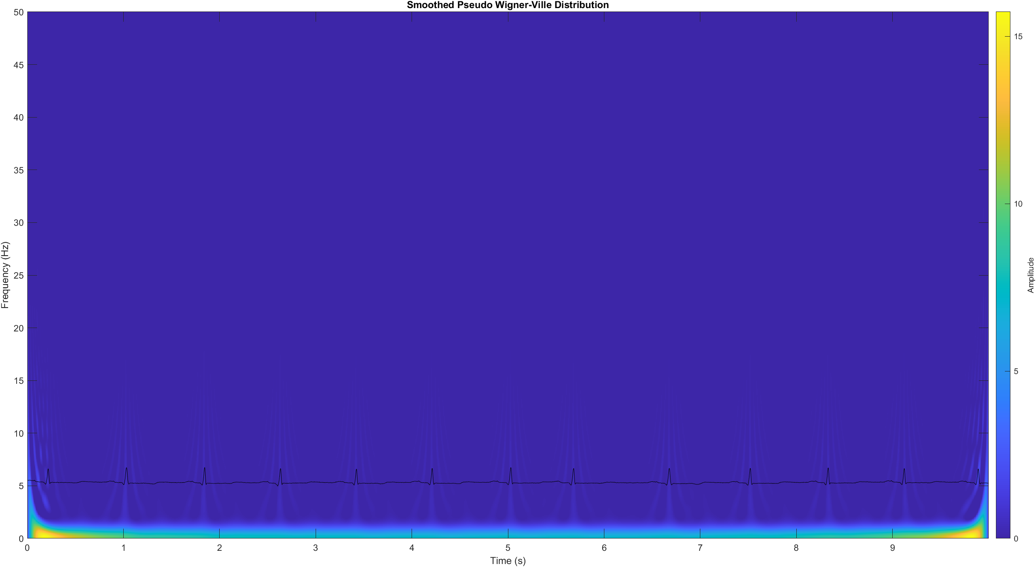
Pseudo WVD
Minimum nonzero value=0
NumFrequencyPoints=2*ceil(length(input)/2)
Notes:
The Psuedo wiener ville distribution is shown here. The QRS peaks are surely being visible but the the maximum detection prominence is given to the lower frequencies comparatively.

Slide 17
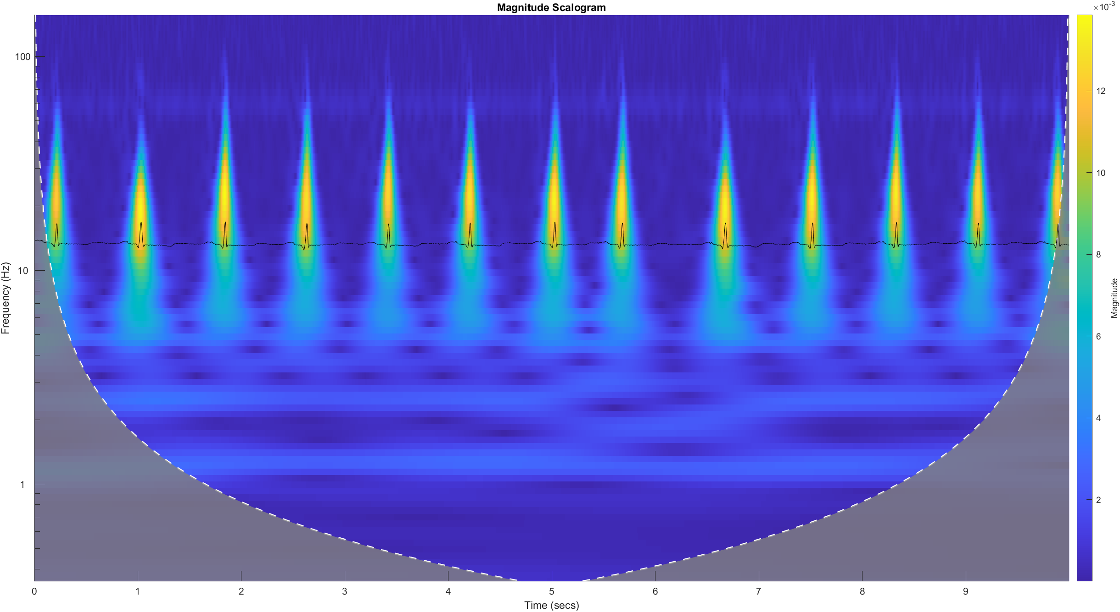
Continuous Wavelet Transform
Wavelet: Morse
Time Bandwidth: 60
Notes:
The CWT with the Morse wavelet and the time bandwidth product of 60 is shown here. The same problem of spreading is seen as with STFT earlier.

Slide 18
Analysis of HHT attributes
Notes:
Now we continue with few more analysis of HHT attributes

Slide 19
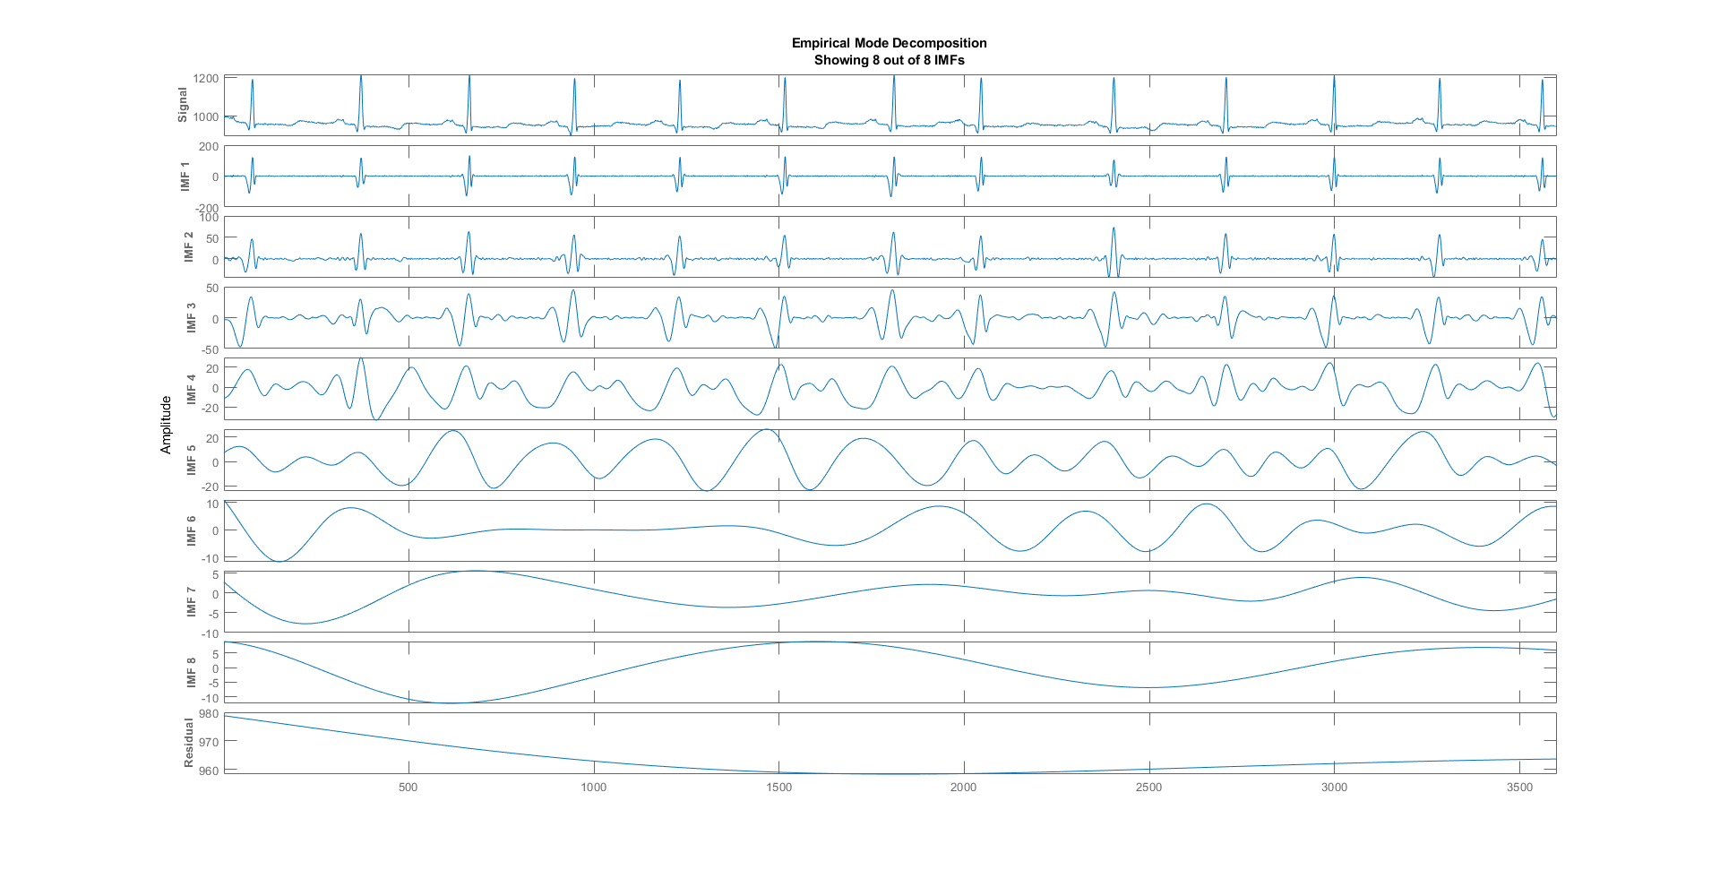
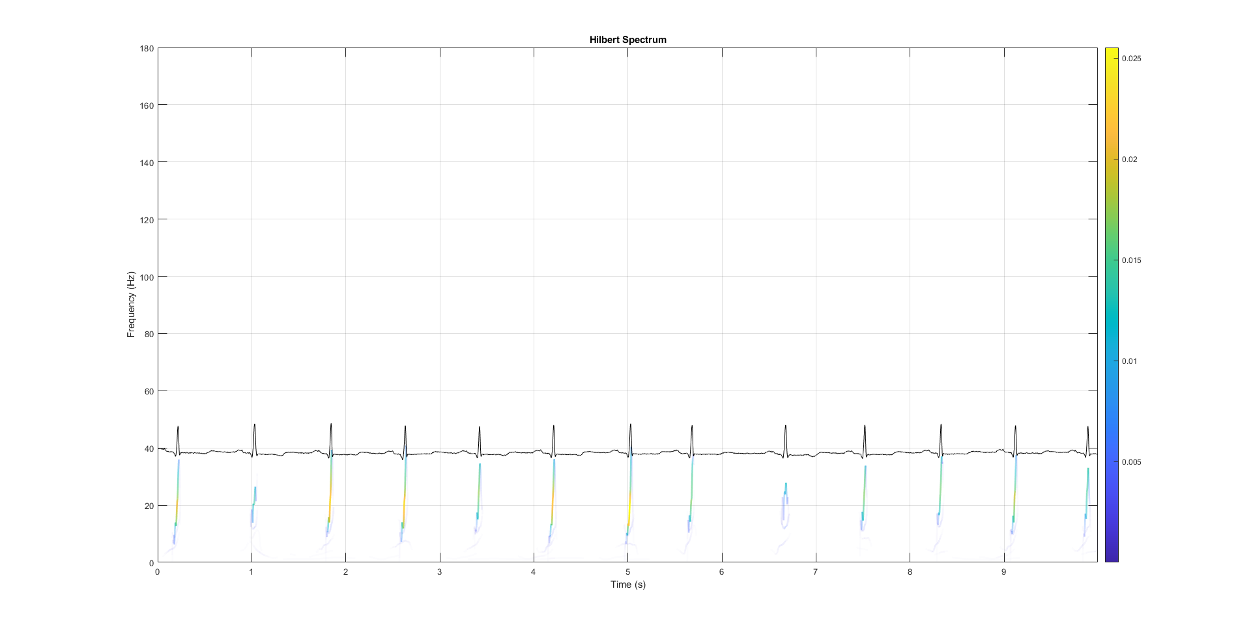
With 8 IMFs
Current IMF | #Sift Iter | Relative Tol | Stop Criterion Hit
1 | 2 | 0.042723 | SiftMaxRelativeTolerance
2 | 2 | 0.11643 | SiftMaxRelativeTolerance
3 | 2 | 0.071968 | SiftMaxRelativeTolerance
4 | 2 | 0.15498 | SiftMaxRelativeTolerance
5 | 2 | 0.016111 | SiftMaxRelativeTolerance
6 | 2 | 0.034947 | SiftMaxRelativeTolerance
7 | 3 | 0.15862 | SiftMaxRelativeTolerance
8 | 2 | 0.031404 | SiftMaxRelativeTolerance
Decomposition stopped because maximum number of intrinsic mode functions was extracted.
Notes:
We have tried to have an early stoppage criteria with varying the maximum number of IMFs to be obtained with the other parameters same for the EMD part of the HHT algorithm. The following few slides show the same. These are the results obtained for 8IMFs

Slide 20
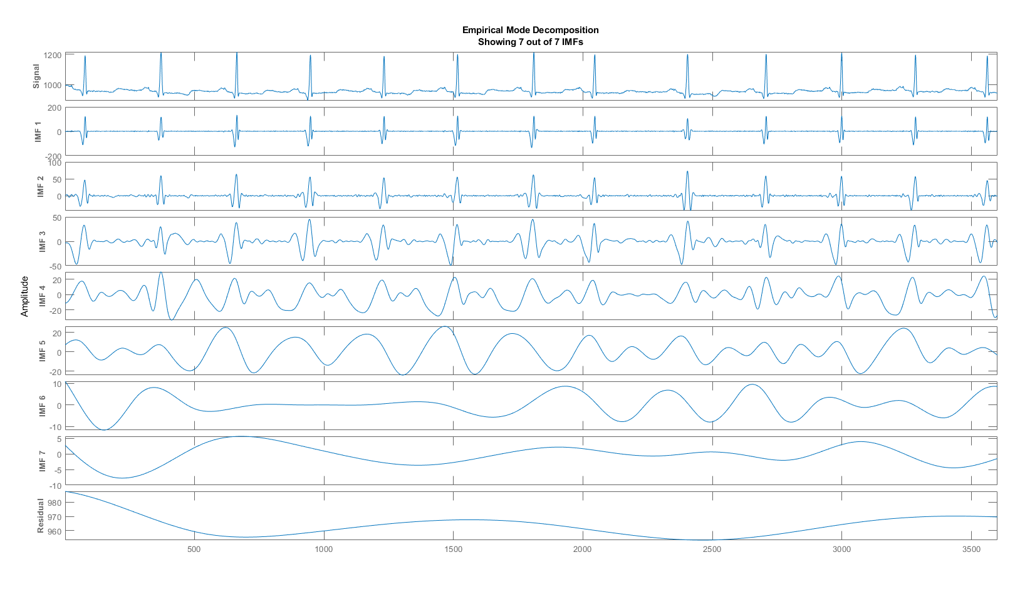
With 7 IMFs
Current IMF | #Sift Iter | Relative Tol | Stop Criterion Hit
1 | 2 | 0.042723 | SiftMaxRelativeTolerance
2 | 2 | 0.11643 | SiftMaxRelativeTolerance
3 | 2 | 0.071968 | SiftMaxRelativeTolerance
4 | 2 | 0.15498 | SiftMaxRelativeTolerance
5 | 2 | 0.016111 | SiftMaxRelativeTolerance
6 | 2 | 0.034947 | SiftMaxRelativeTolerance
7 | 3 | 0.15862 | SiftMaxRelativeTolerance
Decomposition stopped because maximum number of intrinsic mode functions was extracted.
Notes:
These are the results obtained for 7IMFs

Slide 21
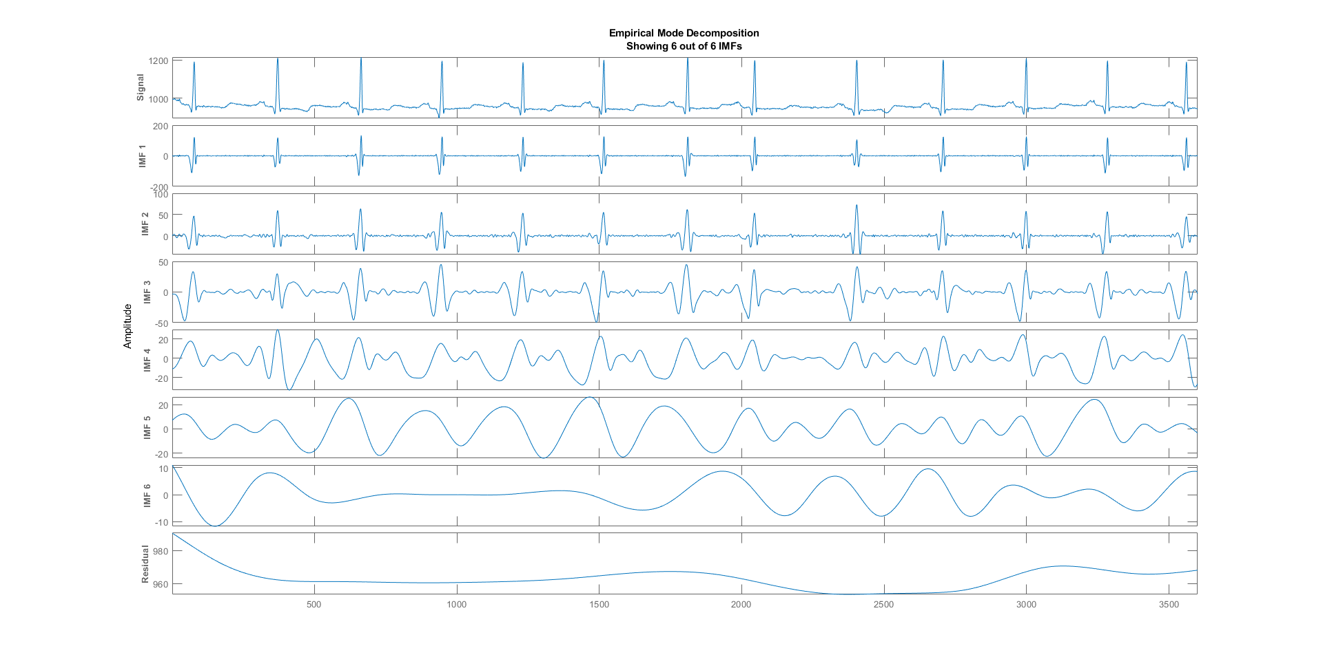

With 6 IMFs
Current IMF | #Sift Iter | Relative Tol | Stop Criterion Hit
1 | 2 | 0.042723 | SiftMaxRelativeTolerance
2 | 2 | 0.11643 | SiftMaxRelativeTolerance
3 | 2 | 0.071968 | SiftMaxRelativeTolerance
4 | 2 | 0.15498 | SiftMaxRelativeTolerance
5 | 2 | 0.016111 | SiftMaxRelativeTolerance
6 | 2 | 0.034947 | SiftMaxRelativeTolerance
Decomposition stopped because maximum number of intrinsic mode functions was extracted.
Notes:
These are the results obtained for 6IMFs

Slide 22
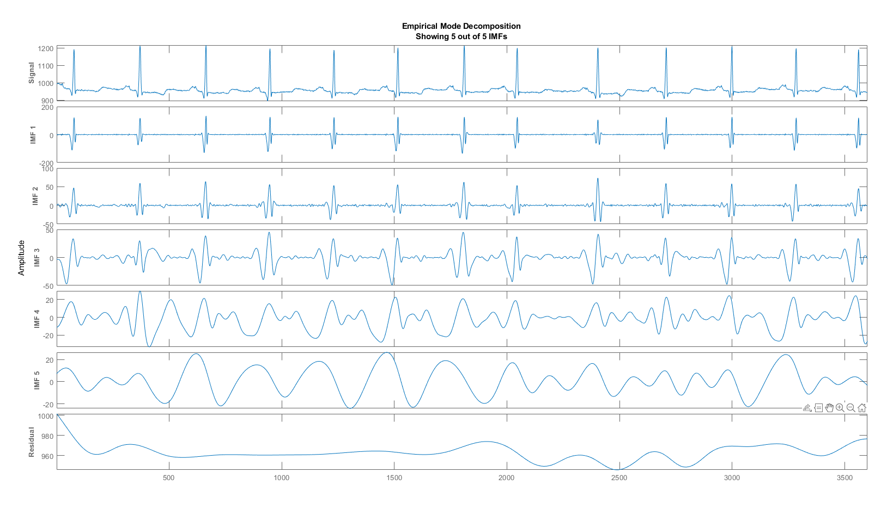
With 5 IMFs
Current IMF | #Sift Iter | Relative Tol | Stop Criterion Hit
1 | 2 | 0.042723 | SiftMaxRelativeTolerance
2 | 2 | 0.11643 | SiftMaxRelativeTolerance
3 | 2 | 0.071968 | SiftMaxRelativeTolerance
4 | 2 | 0.15498 | SiftMaxRelativeTolerance
5 | 2 | 0.016111 | SiftMaxRelativeTolerance
Decomposition stopped because maximum number of intrinsic mode functions was extracted.
Notes:
These are the results obtained for 5IMFs

Slide 23
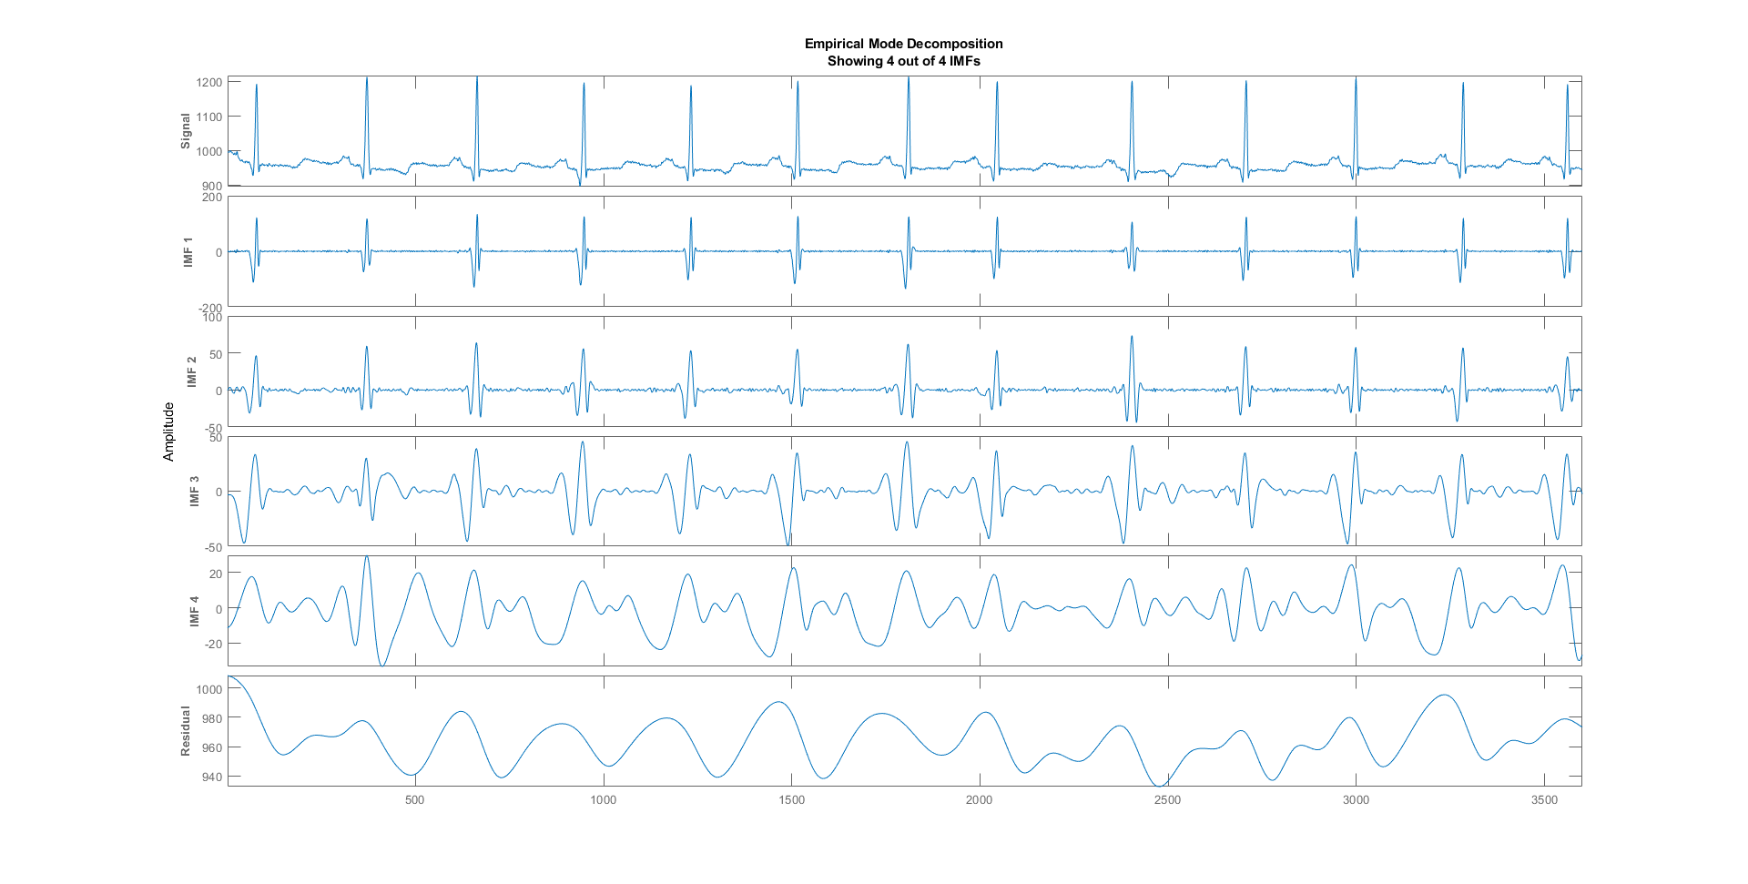

With 4 IMFs
Current IMF | #Sift Iter | Relative Tol | Stop Criterion Hit
1 | 2 | 0.042723 | SiftMaxRelativeTolerance
2 | 2 | 0.11643 | SiftMaxRelativeTolerance
3 | 2 | 0.071968 | SiftMaxRelativeTolerance
4 | 2 | 0.15498 | SiftMaxRelativeTolerance
Decomposition stopped because maximum number of intrinsic mode functions was extracted.
Notes:
These are the results obtained for 4IMFs

Slide 24
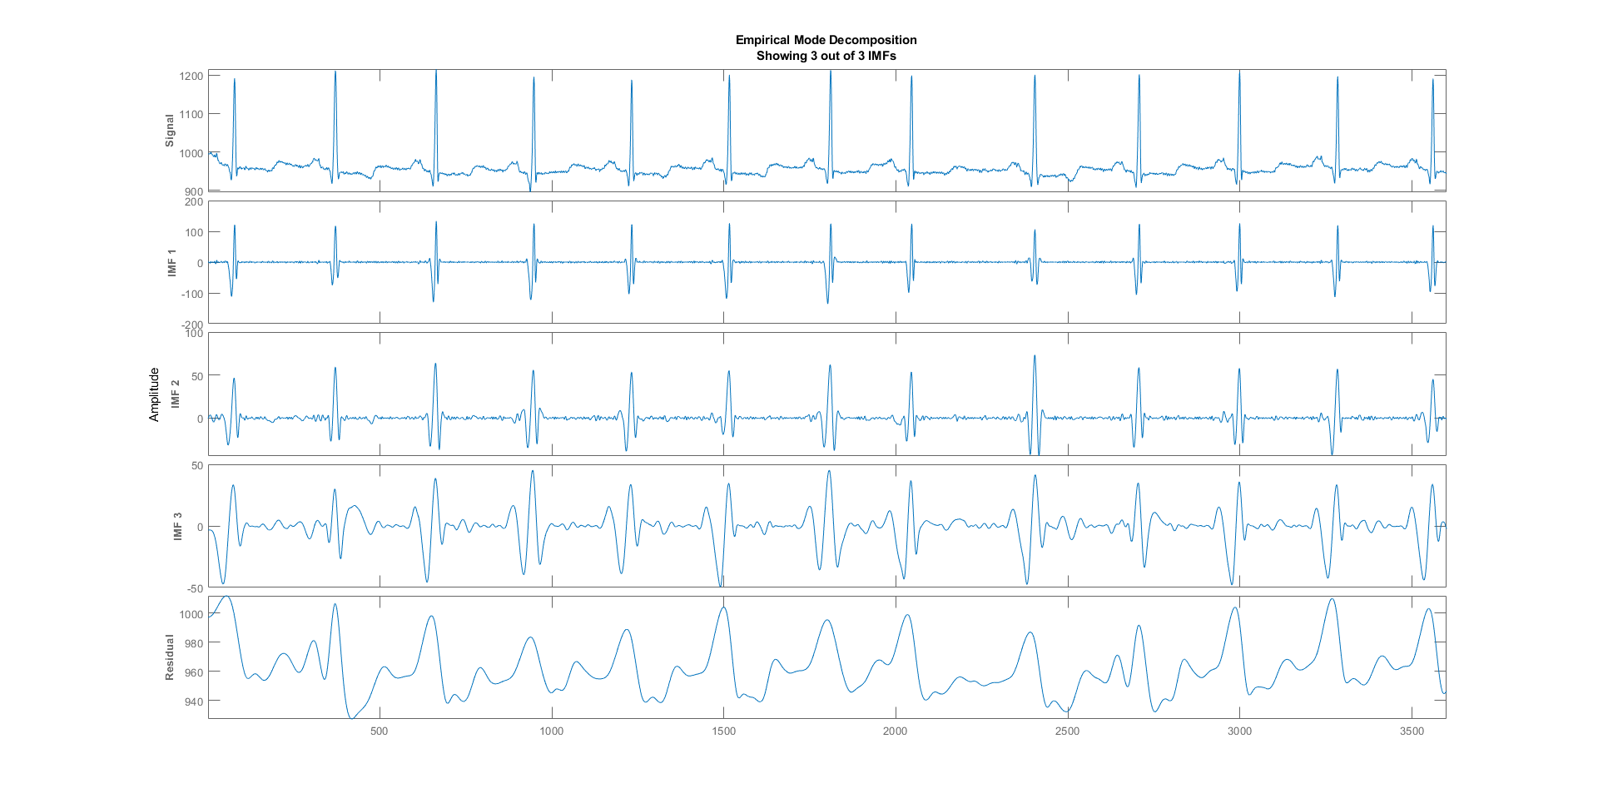

With 3 IMFs
Current IMF | #Sift Iter | Relative Tol | Stop Criterion Hit
1 | 2 | 0.042723 | SiftMaxRelativeTolerance
2 | 2 | 0.11643 | SiftMaxRelativeTolerance
3 | 2 | 0.071968 | SiftMaxRelativeTolerance
Decomposition stopped because maximum number of intrinsic mode functions was extracted.
Notes:
These are the results obtained for 3IMFs

Slide 25
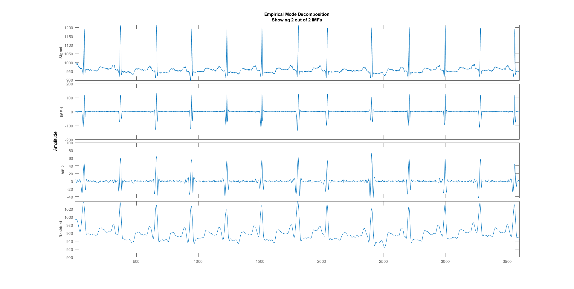

With 2 IMFs
Current IMF | #Sift Iter | Relative Tol | Stop Criterion Hit
1 | 2 | 0.042723 | SiftMaxRelativeTolerance
2 | 2 | 0.11643 | SiftMaxRelativeTolerance
Decomposition stopped because maximum number of intrinsic mode functions was extracted.
Notes:
These are the results obtained for 2IMFs. The important thing to notice is there wasn’t much change in the spectrum even with early stoppage. This is for one ECG signal. But other references have shown that using the early stoppage criteria, we can actually emphasize on few anomaly conditions when compared to using all IMFs. Like for a particular type of arythhmia 5 IMFs was giving a better performance than others. We have tried the other early stoppage conditions like Max extrema. But all of them finally would boil down to the number of Imfs

Slide 26
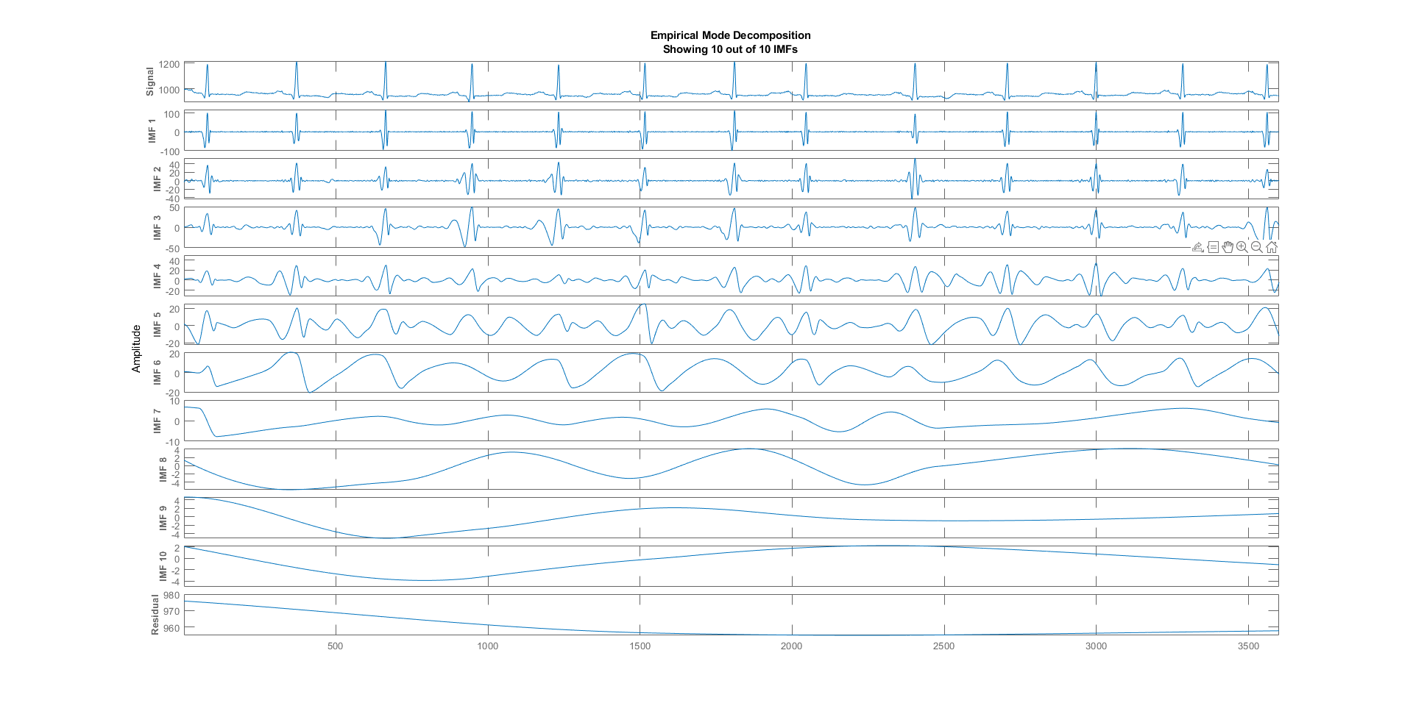

SiftTolerance = 0.1
Notes:
Now, we have experimented by changing the sifttolerance or threshold in the EMD step. This value highly effects the number of IMFs as well as the shape of the residual and the spectrum. By decreasing the value we can get more number of IMFs and a better decreasing function for the residual. The spectrum here is shown for the value of 0.1 which is not much different from the time earlier when its value was 0.2

Slide 27
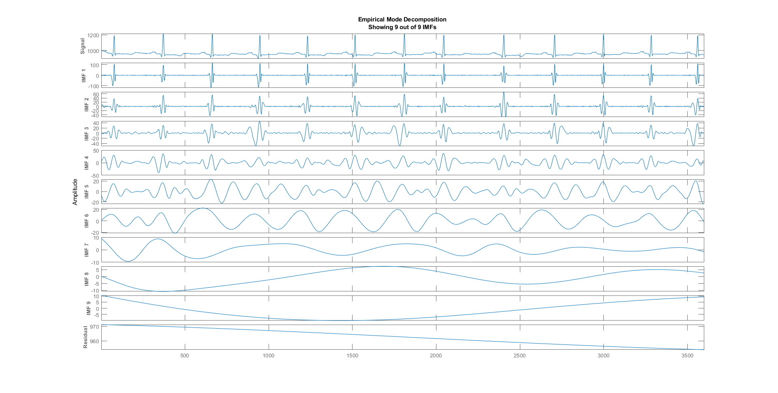

SiftTolerance = 0.01
Notes:
The spectrum here is shown for the value of 0.01 which is not much different from the time earlier when its value was 0.2

Slide 28
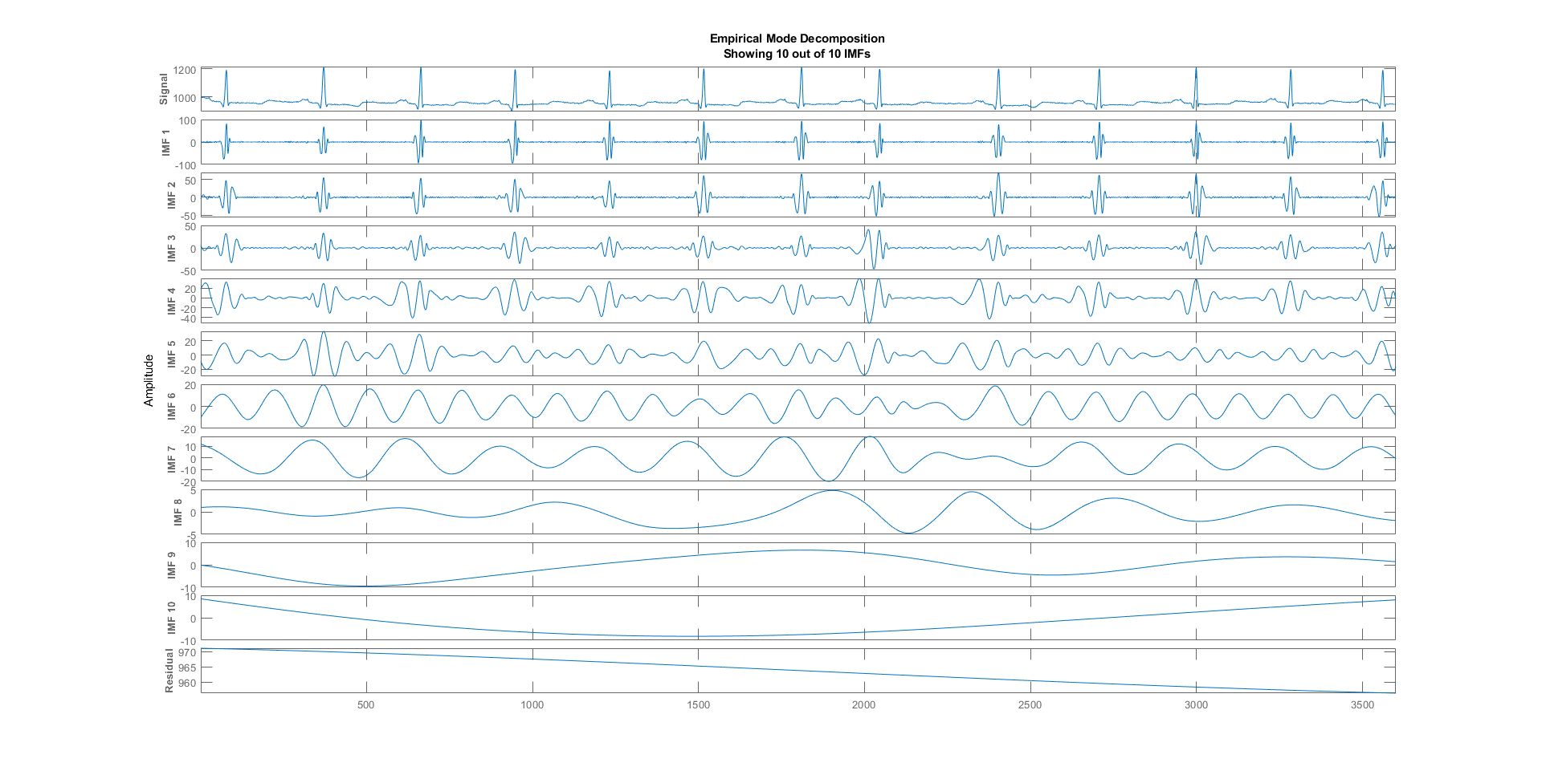
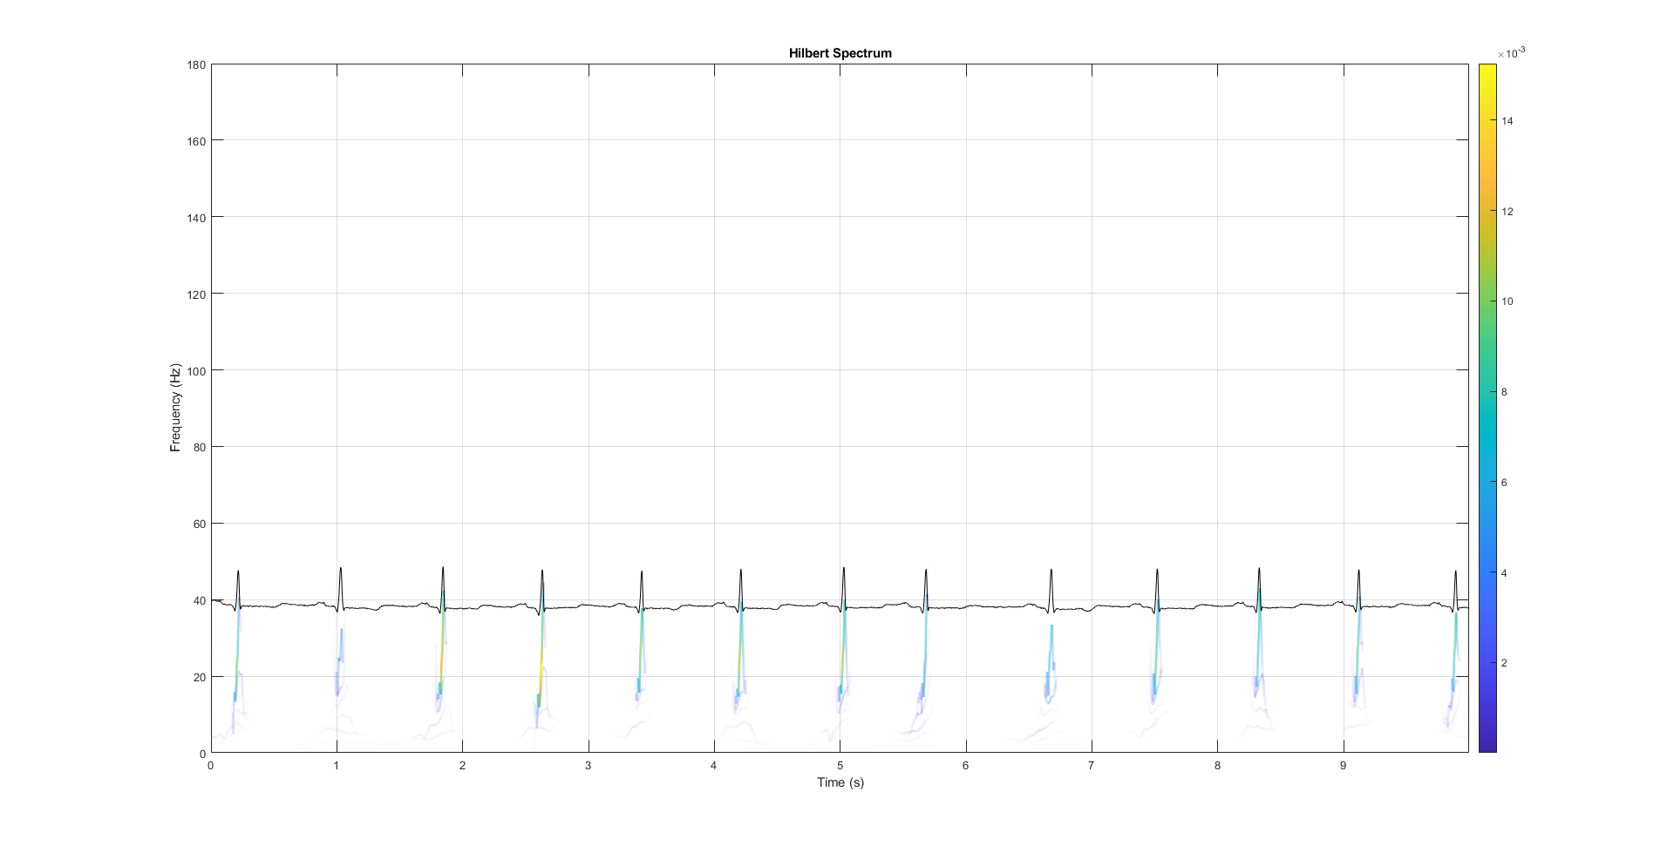
Sift Tolerance = 0.001
Notes:
The spectrum here is shown for the value of 0.1 which is much different from the time earlier when its value was 0.2. Now the Imfs increase to 10. and also one of the peak between 6 and 7 seconds which was missing earlier is emphasized equally with the other peaks.

Slide 29
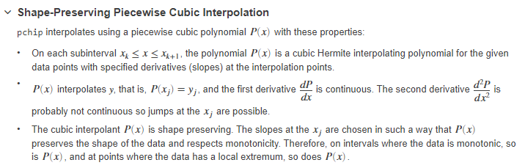
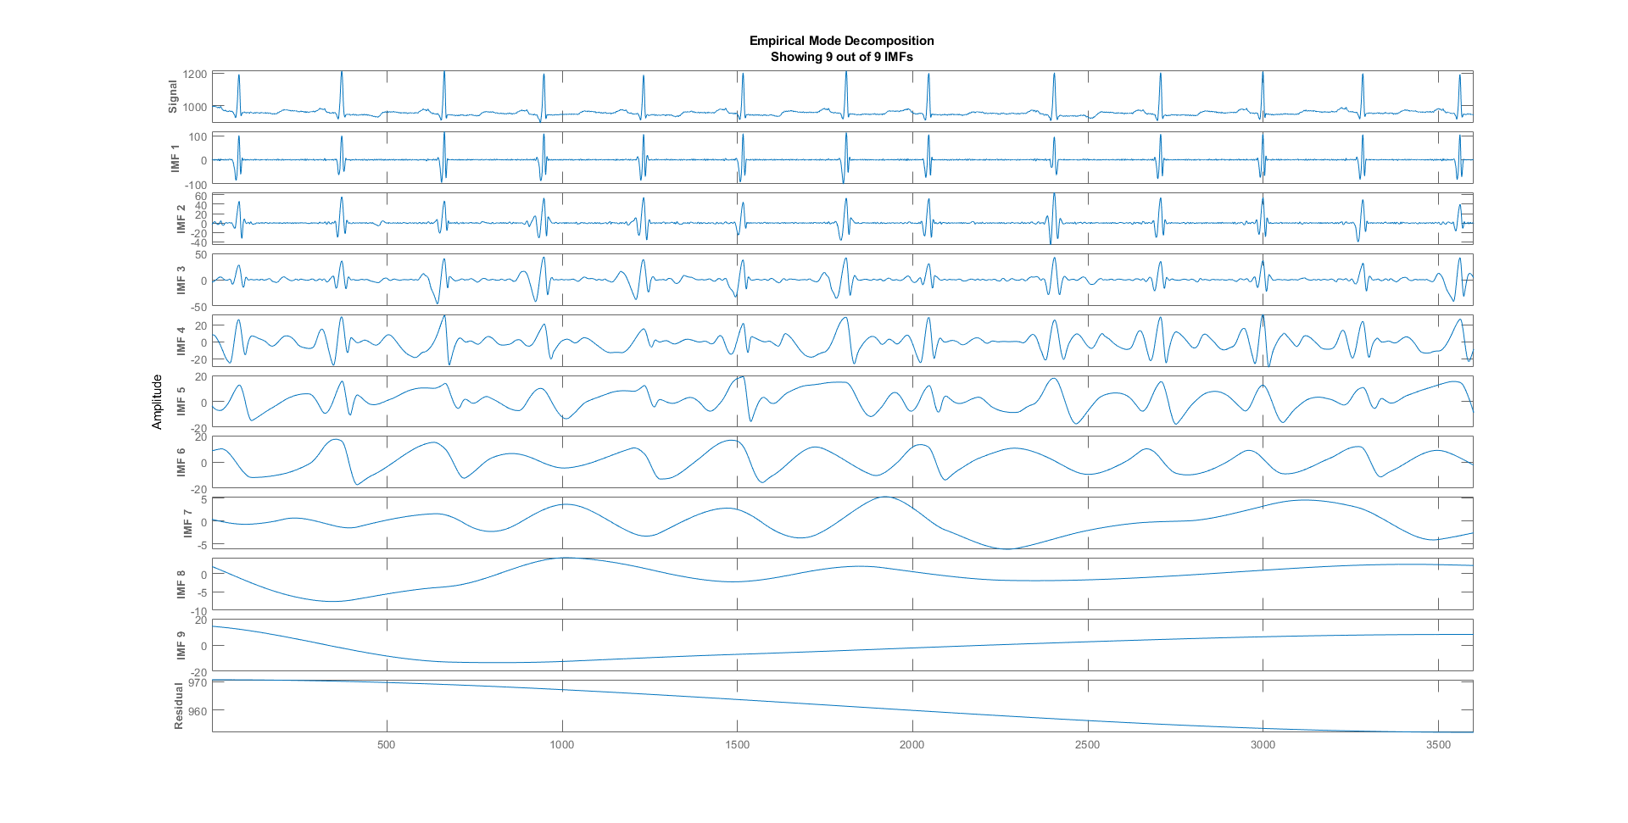

Using Pchip Interpolation for 9 IMFs
Notes:
Now, we have experimented by changing the interpolation in the EMD step. We have tried to use shape preserving piecewise cubic interpolation as explained here instead of spline which was used earlier. Pchip is mainly used for non smooth signals, which in our case is more better fit.

Slide 30
Conclusion
HHT has been shown to exactly identity the QRS peak in the Time frequency domain.
The Wigner Ville and STFT seem good enough approaches, none could have a excellent results due to a fine frequency resolution requires a large window which will, on the other hand, violate the stationary conditions.
Choice of the analyzing window is problematic, and is the ECG is a very low frequency signal.
For wavelet, a important point is the selection of threshold, scaling and the type of wavelet for different types of arrhythmia conditions.
On the other hand, HHT is almost a non-parametric approach for the TF analysis for the ECG signal.

Slide 31
References
Chin-Feng Lin, and Jin-De Zhu ,HHT-Based Time-Frequency Analysis Method for Biomedical Signal Applications, Recent Advances in Circuits, Systems, Signal and Telecommunications.
Cervantes et. al., Frequency, time-frequency and wavelet analysis of ECG signal, 2006 Multiconference on Electronics and Photonics.
Bhargav Lenka, Time-frequency analysis of non-stationary electrocardiogram signals using Hilbert-Huang Transform, 2015 International Conference on Communications and Signal Processing (ICCSP).
WANG, GANG; CHEN, XIAN-YAO; QIAO, FANG-LI; WU, ZHAOHUA; HUANG, NORDEN E. (2010). ON INTRINSIC MODE FUNCTION. Advances in Adaptive Data Analysis, 2(3), 277–293. doi:10.1142/S1793536910000549

